Slide 1

Strategic Review
The Mad Katas
May 2021
Notes:
Welcome to our strategic review of the Sysops Squad system.
🖱️

Slide 2
A solution is needed, and needs to be enacted quickly to save this arm of the Penultimate Electronics business.
Notes:
There are big problems with the current system.
A solution is needed, and needs to be enacted quickly to save this arm of the Penultimate Electronics business.
🖱️

Slide 3
Problems
With the current Sysops Squad system
Notes:
Let’s look at the problems we are currently experiencing…
🖱️

Slide 4




The person who showed up couldn’t fix my printer!
I stayed in all day and no one showed up!
My laptop won’t turn on, and when I called your operator said the ticket system was down!
I needed help with my electric hob but the website wouldn’t load!
Notes:
Our customers are not happy.
The wrong expert is showing up, or no expert at all.
🖱️When they need help the system isn’t always available.
🖱️

Slide 5



I knew I had a job to go to, but the ticket information wouldn’t load!
It was so embarrassing having to say the system had sent the wrong person!
The system keeps freezing up and when we make changes something else breaks!
Notes:
Our employees are not happy.
Experts can’t always access the information they need or are sent to the wrong job.
🖱️Our developers are struggling to maintain and update the system.

Slide 6

We are throwing money down the drain!
Customers will be cancelling their contracts and going elsewhere.
The brand image is being tarnished.
Notes:
Penultimate Electronics are seeing Sysops Squad as a 🖱️ drain on money and a stain on the brand.
🖱️Customers are going to go elsewhere.

Slide 7
Tickets are a problem.
Availability and Scalability are secondary
Notes:
Tickets are the problem, and this is where we will focus our resources for maximum impact.

Slide 8
Updated Ticket Workflows
The workflows for tickets in the new Sysops system.
Notes:
The current workflows need a little adjustment to improve the overall ticket workflow
🖱️

Slide 9
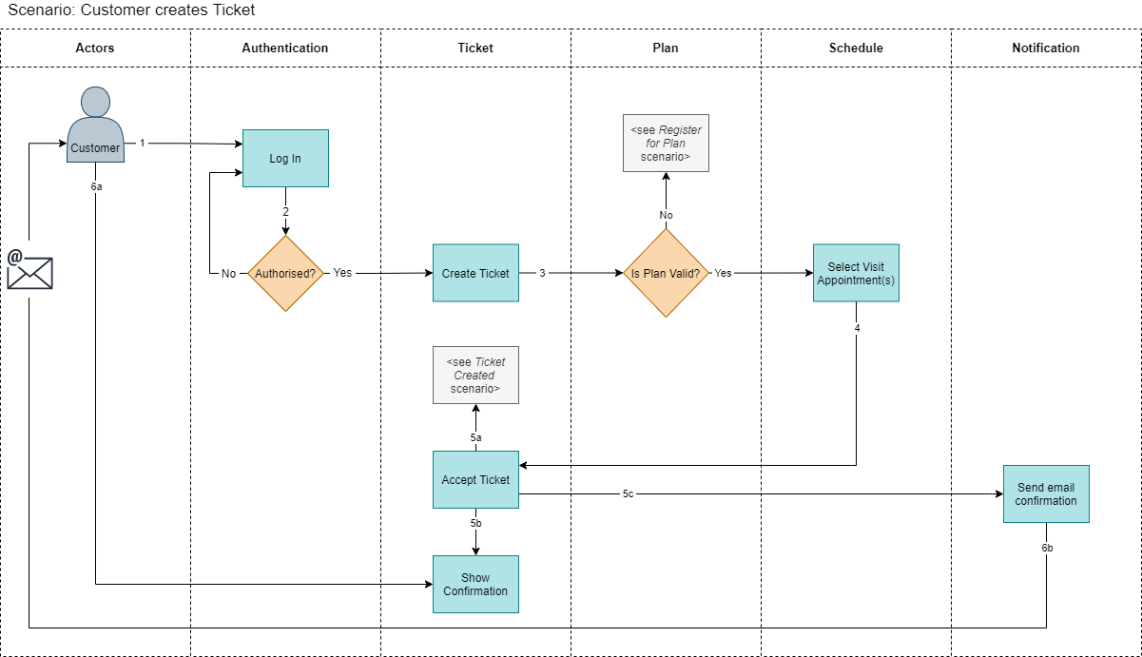
Customer creates a Ticket
Notes:
The customer logs in to the Sysops Squad system
🖱️

Slide 10
Customer creates a Ticket
Notes:
They choose to create a ticket
🖱️

Slide 11
Customer creates a Ticket
Notes:
The system will need to check that the plan they have chosen is valid for their contracts, and redirect them to register a contract if needed.
🖱️

Slide 12
Customer creates a Ticket
Notes:
The customer can then choose one or more appointment times and days, e.g. Tue 1st June morning, or between 2 and 4pm.
This gives us the ability to add plans that cost more and allow the customer to choose shorter time slots, and upsell at this point.
🖱️

Slide 13
Customer creates a Ticket
Notes:
The ticket is accepted by the system and an onscreen and email notification sent to the customer.
🖱️

Slide 14
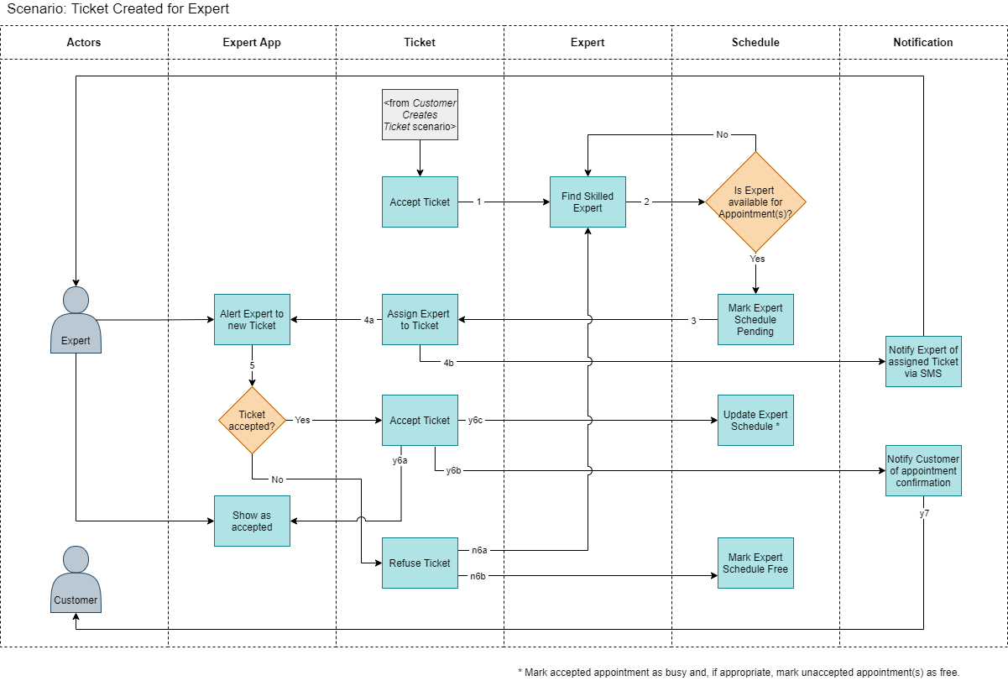
Ticket created for Expert
Notes:
Next the ticket is handled by the system, it finds an expert that matches the required skills and location
🖱️

Slide 15
Ticket created for Expert
Notes:
and checks their schedule, which is an addition to the current system and made possible by our choice of database.
If available, their schedule is marked pending, so they are not assigned to another ticket. Else another expert is found.
🖱️

Slide 16
Ticket created for Expert
Notes:
At this point the ticket is assigned to the expert and they are notified by SMS and the mobile app.
🖱️

Slide 17
Ticket created for Expert
Notes:
The expert can then choose to accept the ticket, and may have a choice of appointment times.
This is another change, adding resilience and automation to the system where the expert may not be able to take on a ticket.
🖱️

Slide 18
Ticket created for Expert
Notes:
If accepted the expert sees confirmation and the customer is notified of their appointment confirmation.
🖱️

Slide 19
Ticket created for Expert
Notes:
If the expert rejects the ticket, maybe they now have a medical appointment, their schedule is cleared of the pending status and the system finds another expert.
🖱️

Slide 20
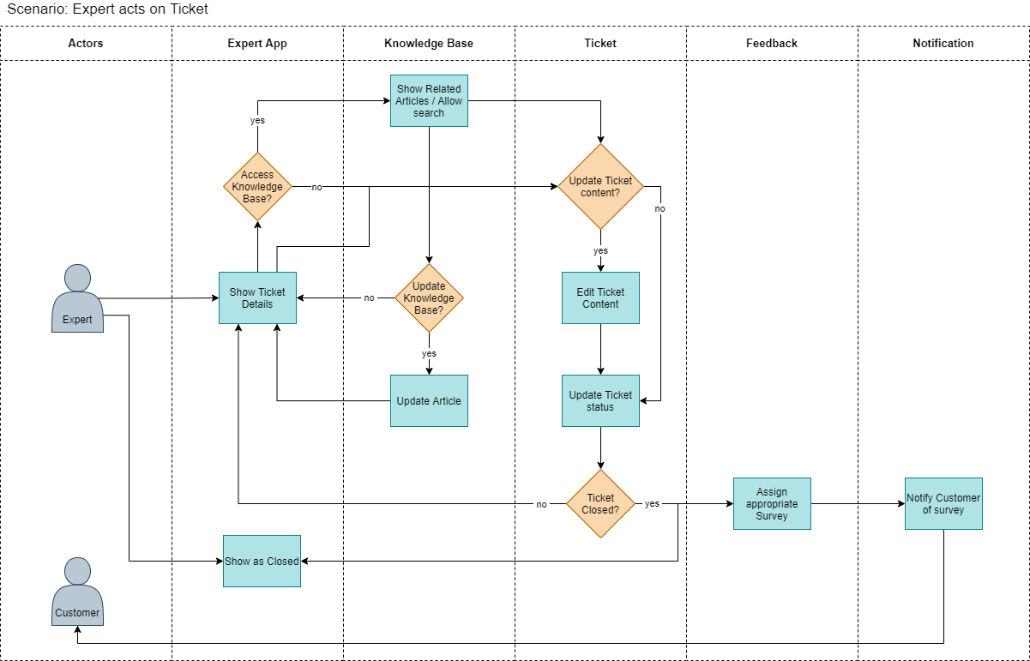
Expert acts on Ticket
Notes:
The expert views ticket information via the mobile app.
🖱️

Slide 21
Expert acts on Ticket
Notes:
If they wish to access the knowledge base they can search for related articles and update them if needed.
🖱️

Slide 22
Expert acts on Ticket
Notes:
The expert can also update the ticket with additional information, if needed, and update the status.
🖱️

Slide 23
Expert acts on Ticket
Notes:
If they haven’t closed the ticket they can then view the ticket information again.
🖱️

Slide 24
Expert acts on Ticket
Notes:
When the ticket has been closed by the expert the expert sees a confirmation of closure, and the system assigns a survey to the customer and sends them a notification by their preferred method.
🖱️

Slide 25
Tickets
Updating the workflows.
Notes:
We need to update the ticket workflows
🖱️

Slide 26
Customer creates a Ticket
Notes:
The customer can choose one or more appointment times and days
We can upsell shorter time slots, as a bonus.
🖱️

Slide 27
Ticket created for Expert
Notes:
Matching an expert to a ticket is much faster with most processing done within the graph database
🖱️

Slide 28
Ticket created for Expert
Notes:
The expert can then choose to accept the ticket
This change adds resilience and automation to the system
🖱️

Slide 29
Availability & Scalability
And other characteristics.
Notes:
Addressing our other problems
🖱️

Slide 30
Key Architecture Characteristics
Characteristic | Source
Reliability | lost tickets ticket assigned to wrong expert (incorrect skills)
Data Integrity | lost tickets ticket assigned to wrong expert (incorrect skills)
Workflow | lost tickets ticket assigned to wrong expert (incorrect skills)
Scalability/Elasticity | system frequently freezes up / crashes thought to be because of a spike in usage
Availability | the system is not always available for web-based and call-based ticket management
Maintainability | change is difficult and risky change take a long time and usually breaks something else
Testability | change is difficult and risky change take a long time and usually breaks something else

Slide 31
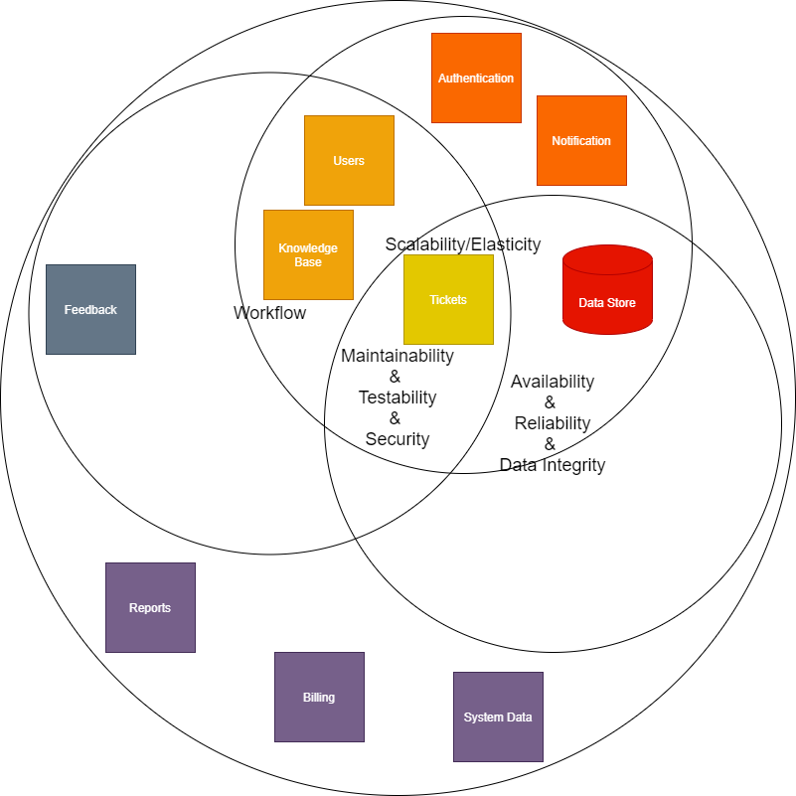
Key Architecture Characteristics
Notes:
We identified key characteristics that affect the whole system or part of it. 🖱️

Slide 32
Key Architecture Characteristics
Notes:
Maintainability, testability and security apply to the whole system
🖱️

Slide 33
Key Architecture Characteristics
Notes:
Scalability and Elasticity apply to parts of the system that see a varied workload, such as ticketing
🖱️

Slide 34
Key Architecture Characteristics
Notes:
There are various workflows in the system, which need a design that minimises complexity of workflow
🖱️

Slide 35
Key Architecture Characteristics
Notes:
Availability, Reliability and Data Integrity apply to the data store and tickets as the most important elements, although our design will enable this for the whole system.
From this Venn diagram we can see that a distributed architecture is required.
🖱️

Slide 36
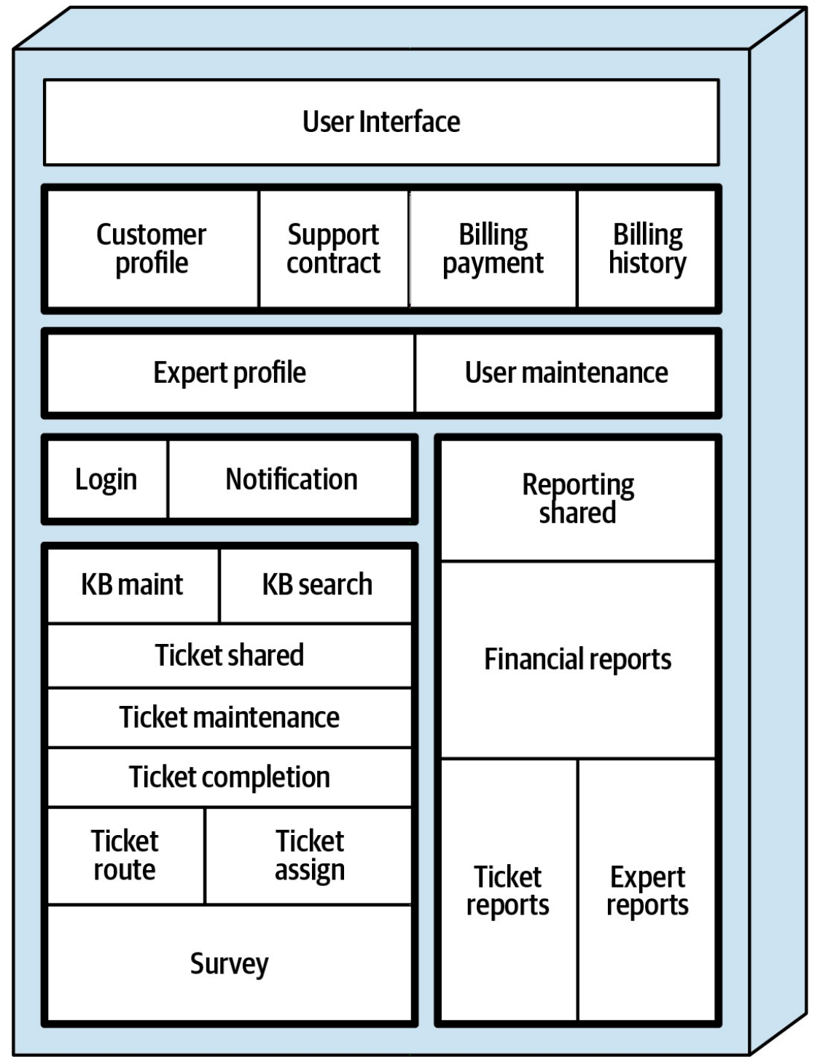
Our current architecture is not distributed
Notes:
Our current architecture is not distributed, causing problems and stopping us from fixing them.
🖱️

Slide 37

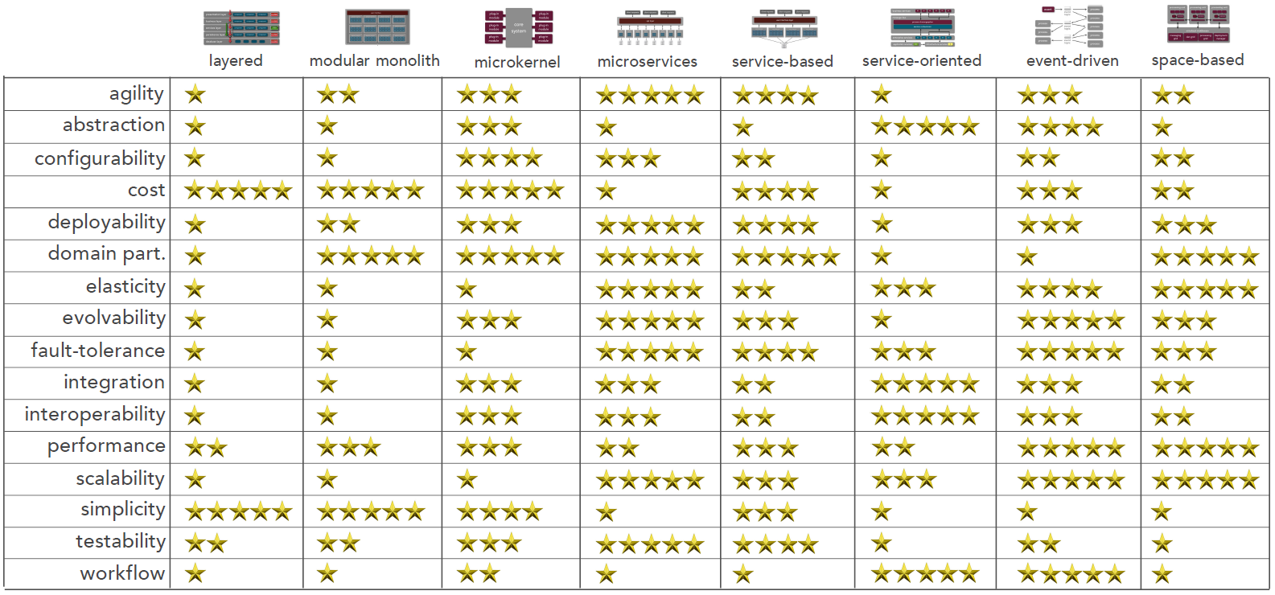
Overall Architecture Style
[original comparison matrix from Understand Architecture Styles (and when to use them) presentation, by Mark Richards]
Notes:
We used the above guide to help decide an architecture style that would have the least trade-offs
The requirement of a distributed architecture 🖱️ removes three options straight away!
🖱️In addition we looked at 🖱️ Fault-Tolerance (linked to reliability) and Agility (linked to testing and deployment problems)
🖱️

Slide 38
Overall Architecture Style
Notes:
We then highlighted the 4 and 5-star rated patterns, but we didn’t stop there and blindly follow a simple tally based on this matrix.
We then examined 🖱️ Microservices, Service-Based and Event-Driven architectures.
With more time we would have attempted to diagram the Sysops system in all three architectures and then make a decision but, with the time we had, we considered the trade-offs for each pattern.
🖱️

Slide 39
Overall Architecture Style
Notes:
We highlighted the 4 and 5-star rated patterns, but we didn’t stop there and blindly follow a simple tally based on this matrix.
We then examined 🖱️ Microservices, Service-Based and Event-Driven architectures.
🖱️

Slide 40
Overall Architecture Style
Notes:
Microservices
- Scores highly on all but workflow, but workflow is key to the main area of ticketing in the Sysops System. This would be a big trade-off.
It Requires that the database be split along with each microservice. This would be very complex and another big trade-off.
🖱️Elasticity and scalability score highly, and these could be key to solving the freezing problems (although we aren't sure of the real reason).
🖱️

Slide 41
Overall Architecture Style
Notes:
Service-Based
Scores highly on 🖱️Agility, Fault-Tolerance and Testability, all three important to development of a new system and the problems associated with making updates to the old system.
Although it apparently scores low on 🖱️ elasticity and scalability, these low scores can be raised by using containerisation, and a graph database that is fast and can also be scaled. So this trade-off is mitigated.
The low score for 🖱️ workflow can also be mitigated by using orchestrator services and queues. So this trade-off is mitigated.
🖱️

Slide 42
Overall Architecture Style
Notes:
Event-Driven
🖱️Elasticity and scalability score highly, and these could be key to solving the freezing problems (although we aren't sure of the real reason).
🖱️Fault-tolerance scores highly, but agility has a middling score. A medium trade-off.
🖱️Workflow scores highly, which is important for the system, but testability has a low score. This would be a big trade-off considering the current problems with testing of deployments.
🖱️

Slide 43
Decision: We will use a service-based back-end architecture
The trade-offs can all be mitigated
Notes:
This all informed our decision to use a service-based architecture
🖱️

Slide 44
Availability & Scalability
And other characteristics.
Notes:
Addressing our other problems
🖱️

Slide 45
Key Architecture Characteristics
Notes:
We can see that a distributed architecture is required due to the varied key characteristics and the need for scalability.
🖱️

Slide 46
Our current architecture is not distributed
Notes:
Our current architecture is not distributed, causing problems and stopping us from fixing them.
🖱️

Slide 47
Overall Architecture Style
Notes:
We are looking for an architecture style with the least trade-offs
We highlighted the highest rated patterns, but we didn’t stop there and blindly follow a simple tally.
We analysed 🖱️ the top three patterns.
🖱️

Slide 48
Overall Architecture Style
Notes:
- The low score on workflow and needing to split the database for microservices are big trade offs
🖱️

Slide 49
Overall Architecture Style
Notes:
elasticity, scalability and workflow in service-based can be mitigated using containerisation, a graph database, orchestrator services and queues.
🖱️ service-based scores best for low cost of implementation and we have high agility

Slide 50
Overall Architecture Style
Notes:
🖱️Agility in event-driven is a medium trade-off.
🖱️testability is a big trade-off.

Slide 51
Decision: We will use a service-based back-end architecture
The trade-offs can all be mitigated
Notes:
This all informed our decision to use a service-based architecture
🖱️

Slide 52
Data Store
How we store data affects the system
Notes:
How we store data has a large affect on the system and so needs careful analysis
🖱️

Slide 53



Data Store Options
Requirement | Relational | Document | Graph
Data must be accurate when reading and writing
Data should be fast to retrieve
Allow data migration from the current data store
Have high availability
Easy to update the schema
Easily maintainable querying
Manage relationships between all the entities
Notes:
We assessed three types of database against the requirements for our data store.
🖱️A relational store, as the current system has, meets only 3 out of 7 here, with schema updates, easily maintainable queries and relationships being its main trade-offs.
🖱️

Slide 54
Data Store Options
Requirement | Relational | Document | Graph
Data must be accurate when reading and writing
Data should be fast to retrieve
Allow data migration from the current data store
Have high availability
Easy to update the schema
Easily maintainable querying
Manage relationships between all the entities
Notes:
A document database met more of the requirements, but relationships and easily maintained queries were the trade-offs.
🖱️

Slide 55
Data Store Options
Requirement | Relational | Document | Graph
Data must be accurate when reading and writing
Data should be fast to retrieve
Allow data migration from the current data store
Have high availability
Easy to update the schema
Easily maintainable querying
Manage relationships between all the entities
Notes:
A graph database met all these requirements and the ones not included on this slide.
🖱️

Slide 56
ADR: We will use a Graph Database
Meeting all requirements and enabling fast querying as a bonus
Notes:
This all informed our decision to use a graph database.
🖱️It meets all our requirements and enables fast querying of available and skilled experts as a bonus!
🖱️

Slide 57
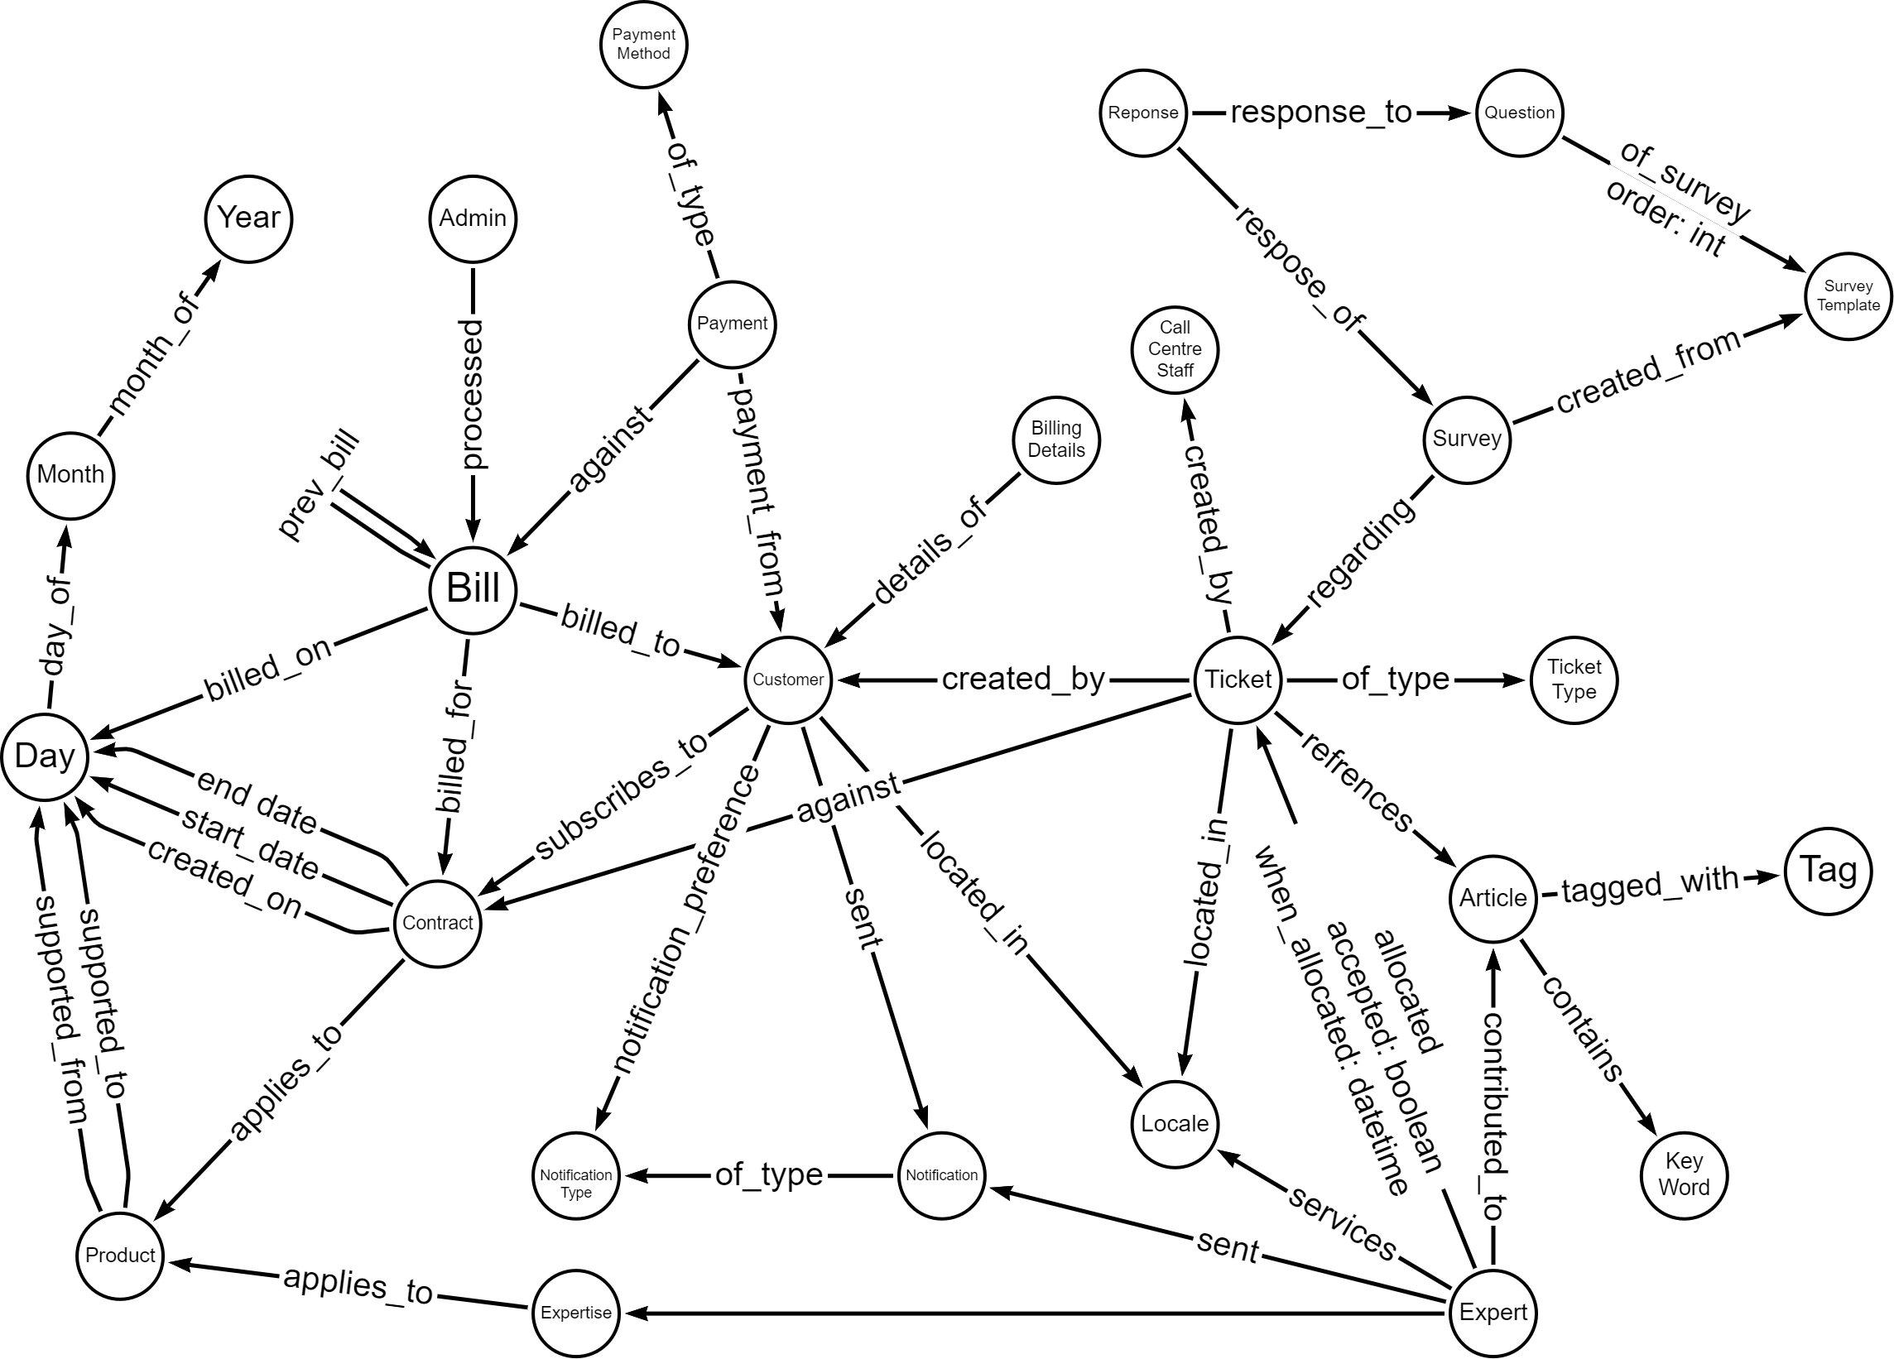
Schema
Notes:
A graph database means that the schema will closely model reality, rather than trying to bend data into joined relational tables.
🖱️ We can see here that the customer ends up central to the schema, which matches reality for the business focus.
🖱️

Slide 58
Data Store
How we store data affects the system
Notes:
We assessed three types of data store
🖱️

Slide 59
Data Store Options
Requirement | Relational | Document | Graph
Data must be accurate when reading and writing
Data should be fast to retrieve
Allow data migration from the current data store
Have high availability
Easy to update the schema
Easily maintainable querying
Manage relationships between all the entities
Notes:
A relational store meets only 3 out of 7 requirements
🖱️

Slide 60
Data Store Options
Requirement | Relational | Document | Graph
Data must be accurate when reading and writing
Data should be fast to retrieve
Allow data migration from the current data store
Have high availability
Easy to update the schema
Easily maintainable querying
Manage relationships between all the entities
Notes:
A document database met more of the requirements
🖱️

Slide 61
Data Store Options
Requirement | Relational | Document | Graph
Data must be accurate when reading and writing
Data should be fast to retrieve
Allow data migration from the current data store
Have high availability
Easy to update the schema
Easily maintainable querying
Manage relationships between all the entities
Notes:
A graph database met all these requirements
🖱️

Slide 62
Decision: We will use a Graph Database
Meeting all requirements and enabling fast complex querying as a bonus
Notes:
This all informed our decision to use a graph database.
It enables fast complex querying as a bonus!
🖱️

Slide 63
Tickets are a problem.
Our biggest problem.
Notes:
So tickets are our biggest problem, let’s fix it.
🖱️

Slide 64
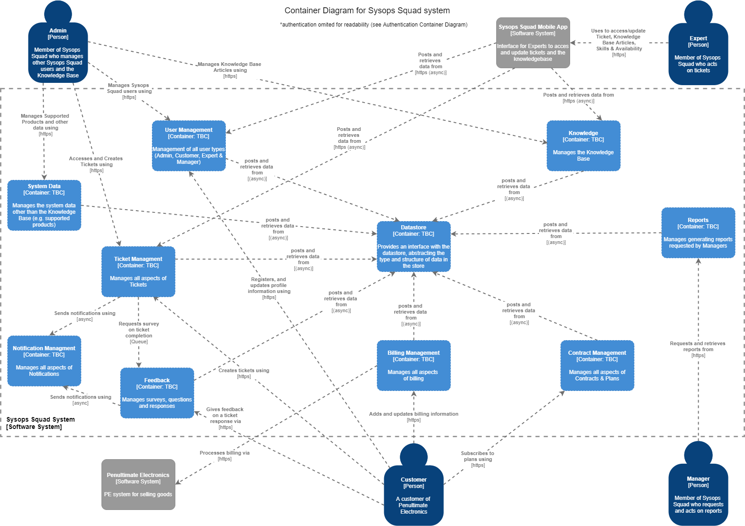
Overview
Notes:
Our design overview started with splitting into domains.
🖱️ We will now focus on breaking down the ticket domain into services.

Slide 65
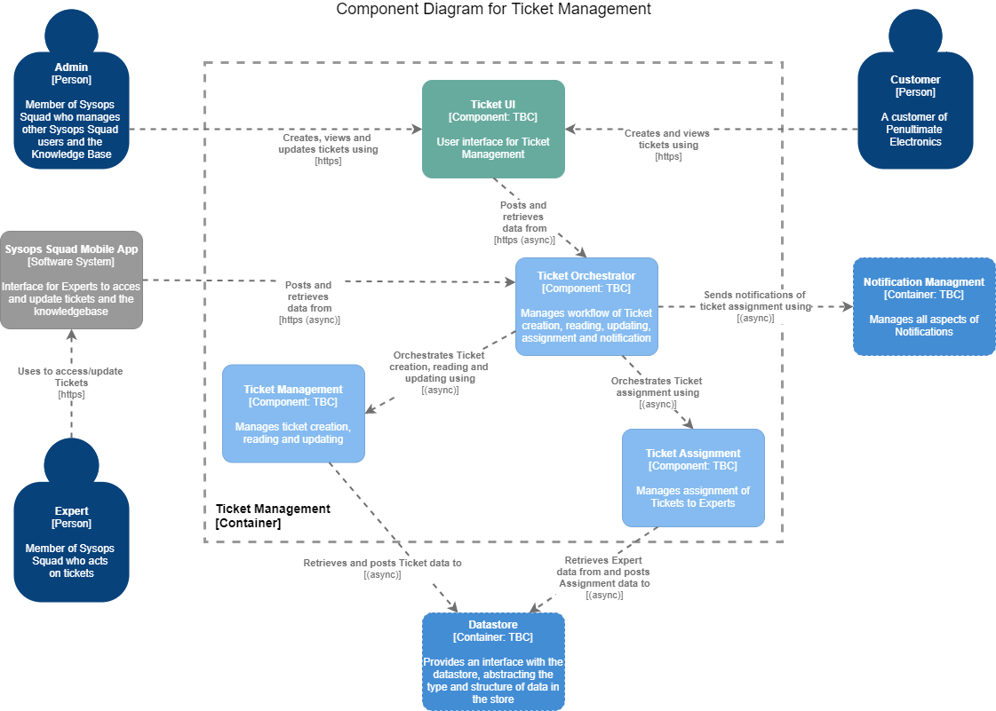
Ticket Domain
ADR: 006 We will separate Ticket-Management
Notes:
Customers, Administrators and Experts all interact with tickets
🖱️

Slide 66
Ticket Domain
ADR: 006 We will separate Ticket-Management
Notes:
Customers and administrators will interact with tickets via the website
Experts via the mobile app
🖱️

Slide 67
Ticket Domain
ADR: 006 We will separate Ticket-Management
Notes:
A ticket orchestrator service will manage the workflow of tickets
🖱️

Slide 68
Ticket Domain
ADR: 006 We will separate Ticket-Management
Notes:
Using the ticket management service to create, retrieve and update tickets
🖱️

Slide 69
Ticket Domain
ADR: 006 We will separate Ticket-Management
Notes:
And the ticket assignment service to assign tickets to experts
🖱️

Slide 70
Ticket Domain
ADR: 006 We will separate Ticket-Management
Notes:
This breakdown means there is no functionality overlap
The potentially volatile code in ticket assignment is segregated
Each service can be scaled as required
And faults in one service do not bring down other services
🖱️

Slide 71
Ticket Domain
ADR: 006 We will separate Ticket-Management
Notes:
The ticket management and assignment services will interact with the data store interface
🖱️

Slide 72
Ticket Domain
ADR: 006 We will separate Ticket-Management
Notes:
And the orchestrator will orchestrate notifications of ticket creation and assignment using the notification service.
It will also use the authentication service to check the validity of requests it receives (not shown on this diagram)
🖱️

Slide 73
Tickets are a problem.
Our biggest problem.
Notes:
So what does service-based mean for tickets?
🖱️

Slide 74
Ticket Domain
ADR: 006 We will separate Ticket-Management
Notes:
The ticket domain will be broken down into services.
🖱️A ticket orchestrator service will manage the workflow of tickets
🖱️

Slide 75
Ticket Domain
ADR: 006 We will separate Ticket-Management
Notes:
We split functionality, volatile code and different scalability needs for a more fault-tolerant system
🖱️

Slide 76
Roadmap
Migrating to the new system
Notes:
The roadmap and migration plan are designed around the need for a quick fix for the key problems with the current Sysops system.
🖱️

Slide 77
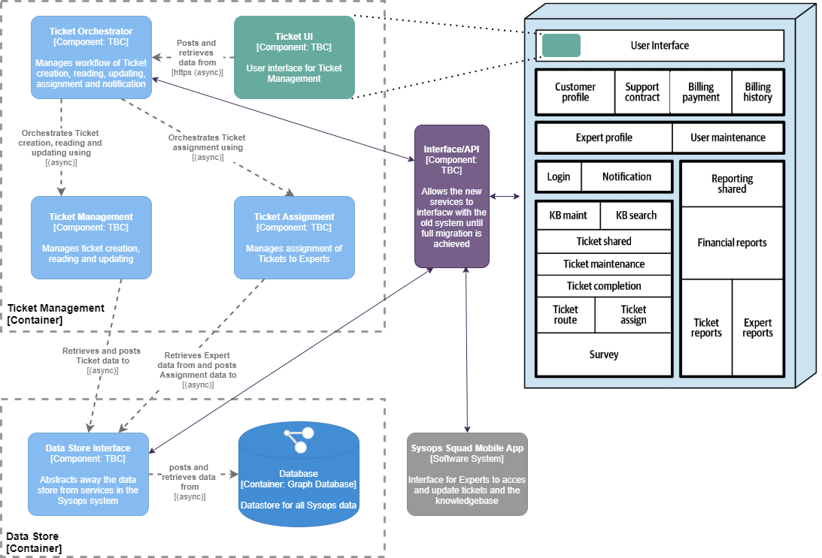
Migration Iteration 1
Notes:
In iteration 1 we focus on the problems with tickets, our biggest headache.
🖱️ The new ticket management services are developed alongside the current system.
🖱️

Slide 78
Migration Iteration 1
Notes:
The new graph database is developed along side the current relational database,
including migration logic for migrating current data into the new database as it is accessed by the new ticket services.
🖱️

Slide 79
Migration Iteration 1
Notes:
Accessing current data and other parts of the system that tickets interact with will be via an interface, which could be an API, with the current system.
This will be developed in this iteration and added to in later iterations with other services.
🖱️

Slide 80
Migration Iteration 1
Notes:
The UI will be developed as a micro-front-end and be embedded in the current UI when the new services go live.
🖱️

Slide 81

Migration Iteration 1
Notes:
The sysops squad app will move to access ticketing via the new interface until it can be updated to use the new services or have the new ticket UI embedded.
🖱️ The final aim with the app will be to embed the same micro-front-end as the website for easy future updates.
🖱️

Slide 82
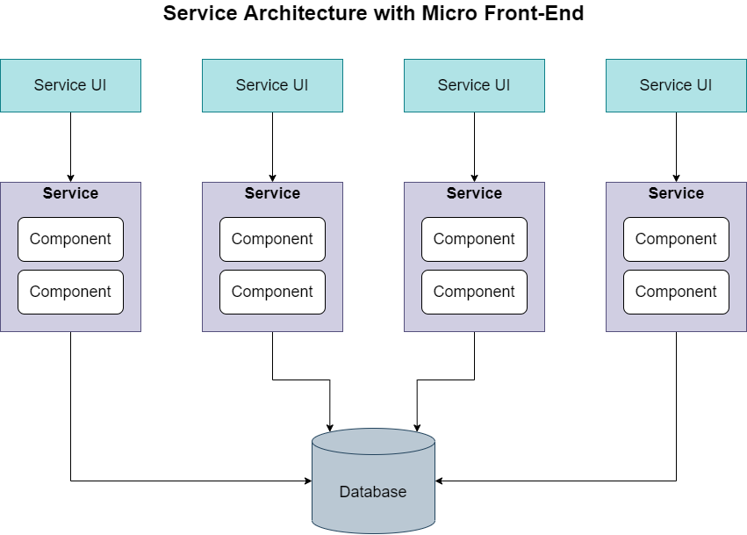
Migration Goal
0
0
Notes:
After the first iteration has gone live successfully there will be 🖱️ further iterations to replace all current services.
Development and testing of each service can run in parallel if resources allow.
🖱️

Slide 83
Migration Goal
Phone App
Website
Notes:
The website will have each micro-UI embedded as the services go live.
🖱️ The phone app will have the relevant micro-UIs embedded as they go live.
🖱️

Slide 84
Roadmap
Migrating to the new system
Notes:
The roadmap and migration plan are designed around the need for a quick fix
🖱️

Slide 85
Migration Iteration 1
Notes:
The new ticket management services and database are developed alongside the current system, along with an interface.
🖱️

Slide 86
Migration Iteration 1
Notes:
The UI will be developed as a micro-front-end and be embedded in the current UI when the new services go live.
🖱️

Slide 87
Migration Iteration 1
Notes:
The sysops squad app will move to access ticketing via the new interface.
🖱️ The same micro-front-end will be embedded in the app for easy updates.
🖱️

Slide 88
Migration Goal
0
0
Notes:
There will be further iterations to replace all current services which can run in parallel if resources allow.
🖱️

Slide 89
Deployment
Enabling scalability, elasticity and fault-tolerance
Notes:
Via deployment we will enable scalability, elasticity and fault-tolerance
🖱️

Slide 90
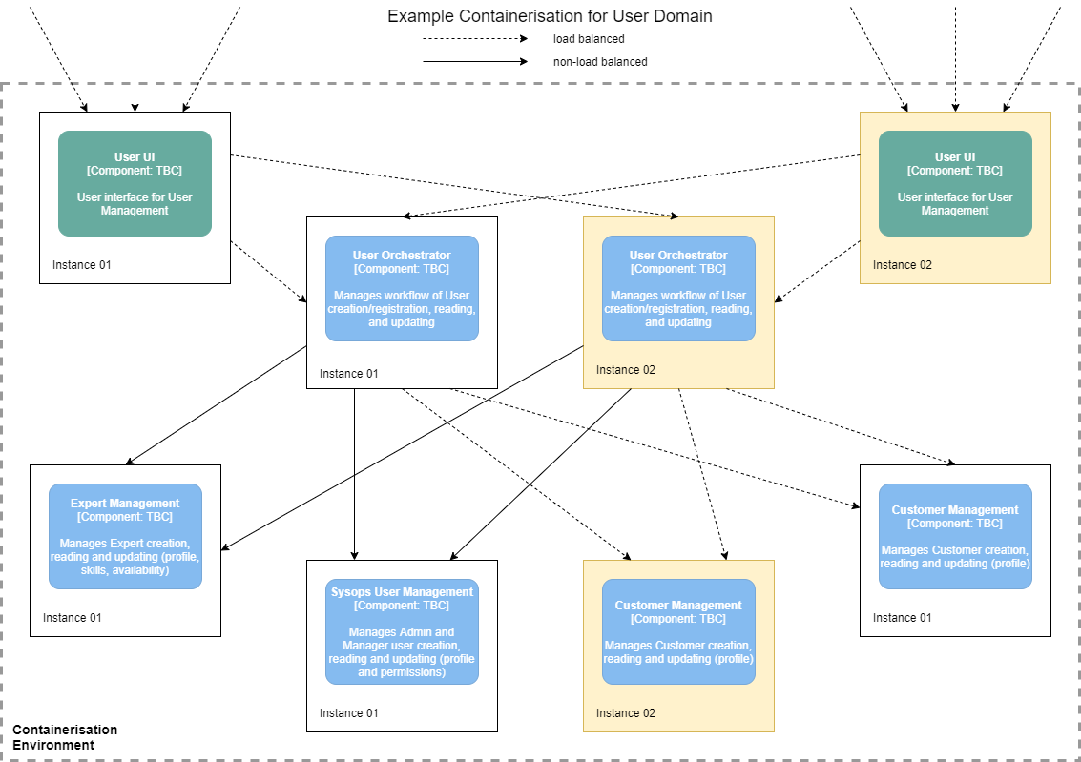
Containerisation
Notes:
Containerisation, using a technology such as Kubernetes, will allow us to scale up and down parts of the system automatically, as and when needed.
Containers will be run on serverless instances, meaning they do not cost money when not using resources in a cloud environment.
If a lot of users are accessing the website then the 🖱️ UI and orchestrator can be scaled up.
If, specifically, a lot of customers are signing up or editing their profile (maybe on the back of a promotion) then the 🖱️ customer management service can also be scaled up.
And when not required the services are scaled down again.
🖱️

Slide 91
Fault Tolerance
Container
Service A
Container
Service B
Container
Service C
Container
Service A
Notes:
A containerisation technology such as Kubernetes has built-in monitoring and fault-tolerance.
If a service or container 🖱️ becomes unresponsive the container manager will 🖱️spin up a new version of the container…
🖱️

Slide 92
Fault Tolerance
Container
Service A
Container
Service B
Container
Service C
Container
Service A
Notes:
If a service or container 🖱️ becomes unresponsive the container manager will 🖱️spin up a new version of the container…
🖱️

Slide 93
Fault Tolerance
Container
Service A
Container
Service B
Container
Service C
Container
Service A
Notes:
to replace it.

Slide 94
Deployment
Enabling scalability, elasticity and fault-tolerance
Notes:
Via deployment we will enable scalability, elasticity and fault-tolerance
🖱️

Slide 95
Containerisation
Notes:
Containerisation will allow us to scale parts of the system automatically.
Maybe a lot of customers access the website on the back of a promotion.
🖱️ the relevant services scale up and then down when not required, and are automatically replaced if they fail
🖱️

Slide 96
Tickets are a problem.
We need to act quickly.
Notes:
In summary: tickets are a big problem and we need to act quickly.
🖱️

Slide 97
Solution Summary
Reliability
Data Integrity
Workflow
Scalability/Elasticity
Availability
Maintainability
Testability
Fault-Tolerance
Agility
Notes:
This solution provides a 🖱️ reliable system architecture with 🖱️ orchestrated workflows leading to high 🖱️data integrity and fast data search and retrieval from a graph database.
The gradual migration enables us to fix our ticket problems fast with an 🖱️ agile system, with containerised deployment enabling 🖱️ scalability, elasticity, 🖱️fault tolerance and 🖱️high availability.
The service-based backend and micro-frontend enable 🖱️maintainability and 🖱️testability.
🖱️

Slide 98
Solution Summary
Reliability
Data Integrity
Workflow
Scalability/Elasticity
Availability
Maintainability
Testability
Fault-Tolerance
Agility
Notes:
This architecture meets all the key characteristics identified

Slide 99




The person who showed up couldn’t fix my printer!
I stayed in all day and no one showed up!
My laptop won’t turn on, and when I called your operator said the ticket system was down!
I needed help with my electric hob but the website wouldn’t load!
Notes:
Customer’s problems are solved quickly
🖱️

Slide 100



I knew I had a job to go to, but the ticket information wouldn’t load!
It was so embarrassing having to say the system had sent the wrong person!
The system keeps freezing up and when we make changes something else breaks!
Notes:
Expert, developer and administrator problems are solved quickly
🖱️

Slide 101
We are throwing money down the drain!
Customers will be cancelling their contracts and going elsewhere.
The brand image is being tarnished.
Notes:
Penultimate Electronic’ problems are solved quickly
🖱️

Slide 102
Questions?
The Mad Katas
https://github.com/tekiegirl/TheMadKatas/
Notes:
We’re happy to answer any questions. Thank you.
🖱️

